Slide 1
Assignment Project Traffic Light using STM32F103RB

Slide 2
Introduction
In this project, the STM32F103RB is used to simulate the 2-way traffic light system, having some main features:
Automatic mode: The system operates as normal. The light colors are red, yellow, and green.
Manual mode: A button is used to switch the light colors in this mode
Tuning mode: This mode is used to modify the light timing length
Pedestrian scramble: when the button for pedestrian is pressed, its light is turned on and operates reversely to the light of vehicles

Slide 3

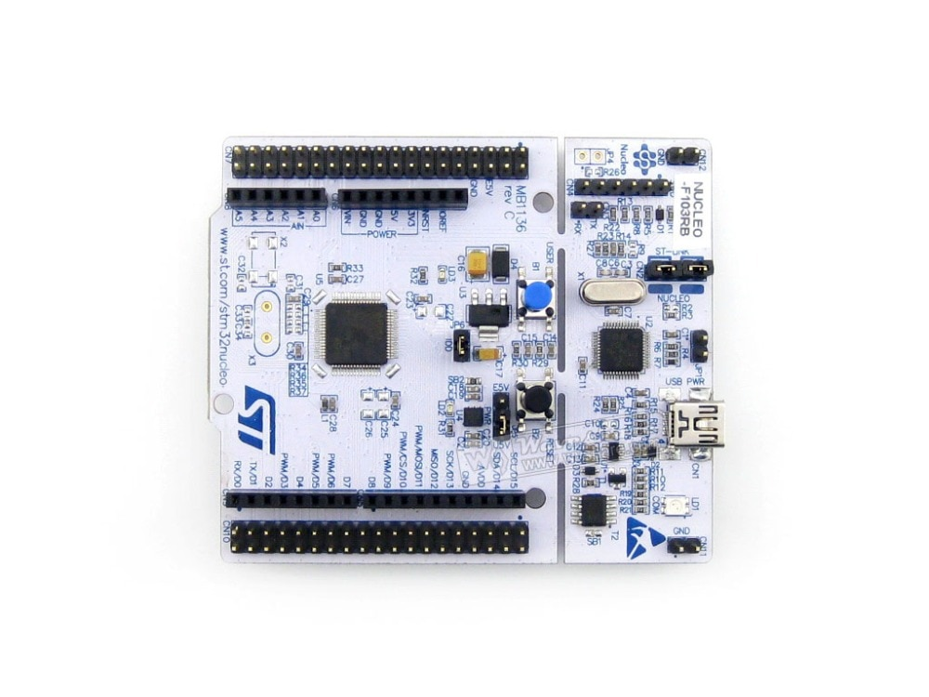
Block Diagram
Pedestrian Light
(D6 – PB10
D7 – PA8)
Traffic Light 1
(D2 – PA10
D3 – PB3)
Traffic Light 2
(D4 – PB5
D5 – PB4)
Pedestrian Buzzer
(D12 – PA6
TIM3-CH1)
USART2
Pedestrian Button
(A0 – PA0)
SELECT
Button
(A1 – PA1)
MODIFY
Button
(A2 – PA4)
SET
Button
(A3 – PB0)

Slide 4
Configuration
Clock: 64MHz
TIM2: PSC = 7999, ARR = 79 => 100Hz clock
TIM3 - PWM: PSC = 63, ARR = 999 => 1kHz clock
USART2, baud rate: 115200

Slide 5
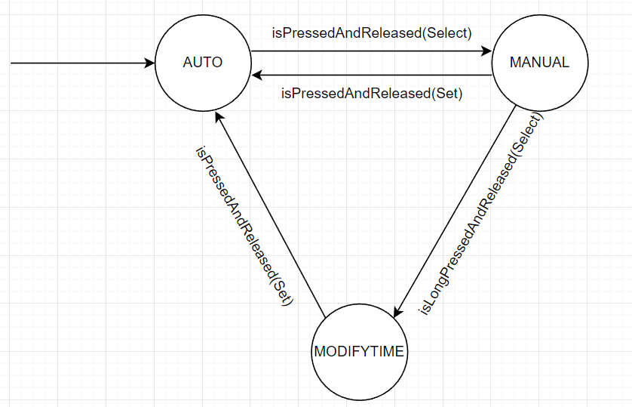
General FSM

Slide 6
Function
AUTO MODE
(Send !AUTOMATIC”)
We use FSM with 5 state:
Init, red_green1, red_yellow1, red_green2, red_yellow2
Function run inside while(1) in main.c
trafficLight_automatic()
trafficLight_change()
trafficLight_manual()
trafficLight_pedestrian()

Slide 7
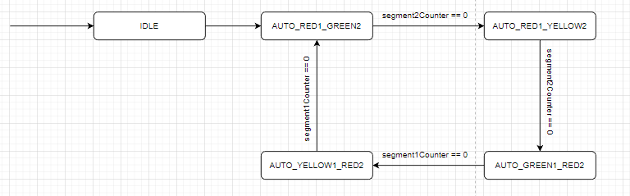

Slide 8
Function
MANUAL MODE
Press ’’SELECT’’ => MANUAL MODE
(Send “!MANUAL” UART)
=> Force change traffic light (For policeman use)
Press ’’MODIFY’’, change the traffic light manually
Press ’’SET’’, return to AUTO MODE

Slide 9
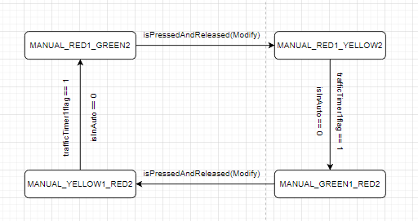

Slide 10
Function
MODIFY TIME MODE
3s press ”SELECT” => (MANUAL) => MODIFY MODE
(Send ”!CHANGE#” UART)
Press ”SELECT” => Change LED color
Press ”MODIFY” => Increase value by 1
Long press ”MODIFY” => Increase by 10 per 1s holding
Press ”SET” => Set value
wait 3 Sec, return Auto Mode
Continue Modify by press ”SELECT”
The value of LED duration would be sync for 2 light.

Slide 11
Function
PEDESTRIAN MODE
Press pedestrian button, then pedestrian led with turn on the opposite light with one line led.
When the led turn yellow, buzzer will play the sound to warn pedestrian hurry up!.
Pedestrian led will turn off in 2 cycle of traffic light. Then, pedestrian button are disable until next light (avoid spam)
When pedestrian led turn “green”, buzzer play “music”

